Slide 1

AWS Cloud Virtual Internship
by
D.CHARAN KUMAR REDDY
Roll No. 214G1A3212
Department of Computer Science and Engineering (Data Science)
Srinivasa Ramanujan Institute of Technology
(Affiliated to JNTUA & Approved by AICTE) (Accredited by NAAC with ‘A’ Grade & Accredited by NBA (EEE, ECE & CSE)
Rotarypuram Village, B K Samudram Mandal, Ananthapuramu – 515701.
2023 - 2024

Slide 2


Contents
AWS Cloud Virtual Internship
Course Objective
Introduction
Types of cloud computing
Services of AWS
Benefits of AWS
Real time applications of AWS
Learning outcomes
Conclusion
GitHub Link
Queries
214G1A32122

Slide 3
Course Objective
AWS Cloud Virtual Internship
Gain a foundational understanding of AWS core services, architecture, and best practices.
Obtain practical experience through real-world projects and use cases, applying AWS services and tools.
Learn to design and implement scalable, reliable, and secure cloud solutions using AWS services.
Develop strategies for optimizing the performance and cost-effectiveness of AWS resources and services.
Acquire skills in deploying, configuring, and managing cloud infrastructure using AWS management tools.
214G1A32122

Slide 4
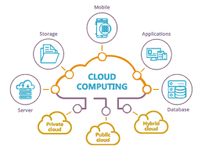
Introduction
AWS Cloud Virtual Internship
What is Cloud Computing?
testing, big data analytics, and customer-facing web applications.
Cloud computing is the delivery of various services over the internet, including data storage, servers, databases, networking, and software.
It's like renting computer resources from a remote location instead of owning and managing your own hardware.
Cloud computing follows Pay-as you-go principle.
214G1A32122

Slide 5
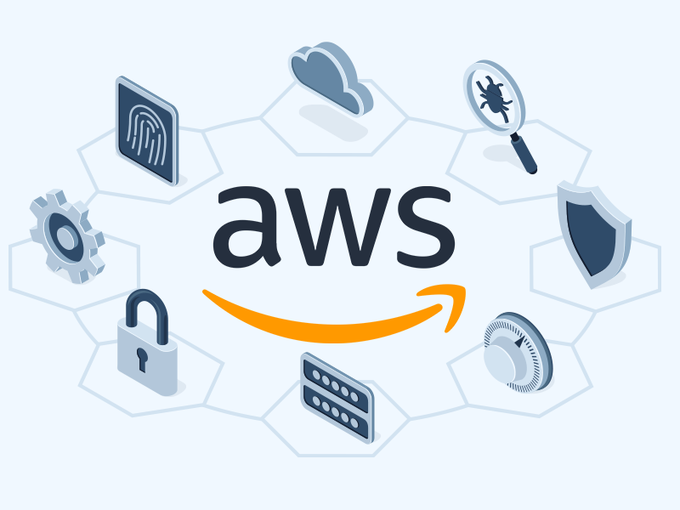
Introduction
AWS Cloud Virtual Internship
What is AWS?
Amazon Web Services (AWS) is the world's most comprehensive and widely adopted cloud platform, offering a broad range of services including compute, storage, databases and enterprise applications.
AWS provides a scalable, reliable, and cost-effective cloud infrastructure platform for business storage management over 190 countries around the world.
214G1A32122

Slide 6
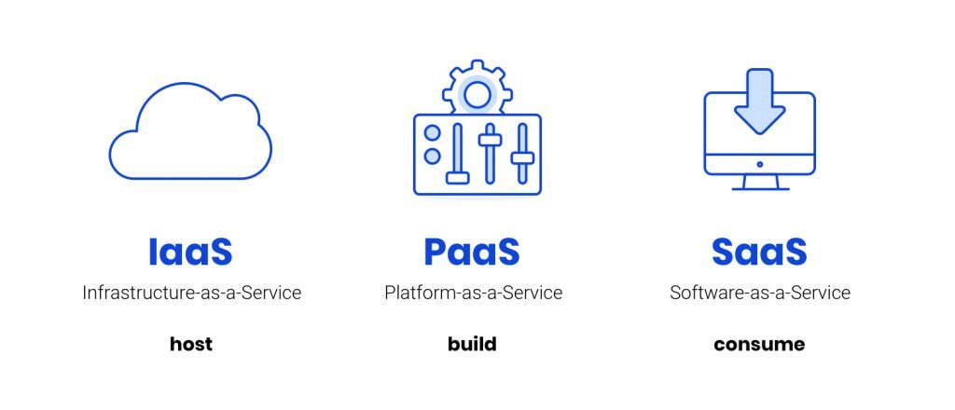
Different Types Of Cloud Computing:
AWS Cloud Virtual Internship
Infrastructure as a Service (laaS):
Infrastructure as a Service (IaaS) is a cloud computing model that allows users to access computing resources on-demand over the internet.
Ex: AWS EC2
2. Platform as a Service (PaaS)
Platform as a Service (PaaS) is a complete cloud environment that includes everything developers need to build, run, and manage applications.
Ex: AWS Elastic Beanstalk
214G1A32122

Slide 7
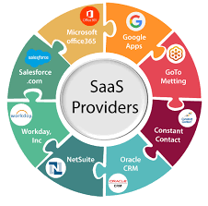
Different types of cloud computing:
AWS Cloud Virtual Internship
3. Software as a Service (SaaS)
Distributes software applications over the internet on a subscription basis. Examples include Google Workspace, Microsoft Office 365, and Salesforce.
SaaS providers are in charge of keeping the software up to date and making sure that everyone has access to the newest features and security patches.
Ex: Netflix, Prime Video etc
214G1A32122

Slide 8
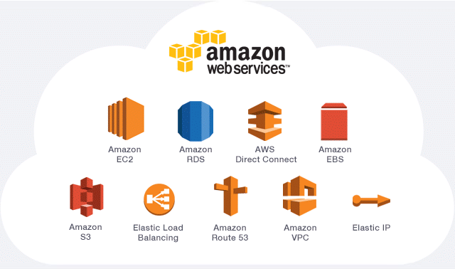
Services of AWS
Amazon Elastic Compute Cloud (Amazon EC2) is a web service that provides secure, resizable compute capacity in the cloud.
EC2 Instance Role provides the Instance access to a set of IAM Credentials and – if the associated IAM Policies permit – access to AWS services.

Slide 9
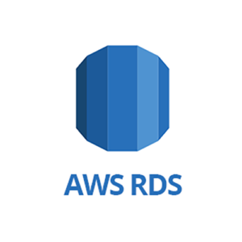
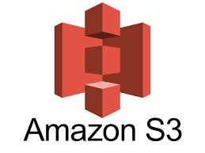
Services of AWS
Amazon Relational Database Service (Amazon RDS) is an easy-to-manage relational database service optimized for total cost of ownership. It is simple to set up, operate, and scale with demand.
Amazon Simple Storage Service (Amazon S3) is an object storage service that offers scalability, data availability, security, and performance. You can use Amazon S3 to store and retrieve any amount of data at any time, from anywhere.

Slide 10
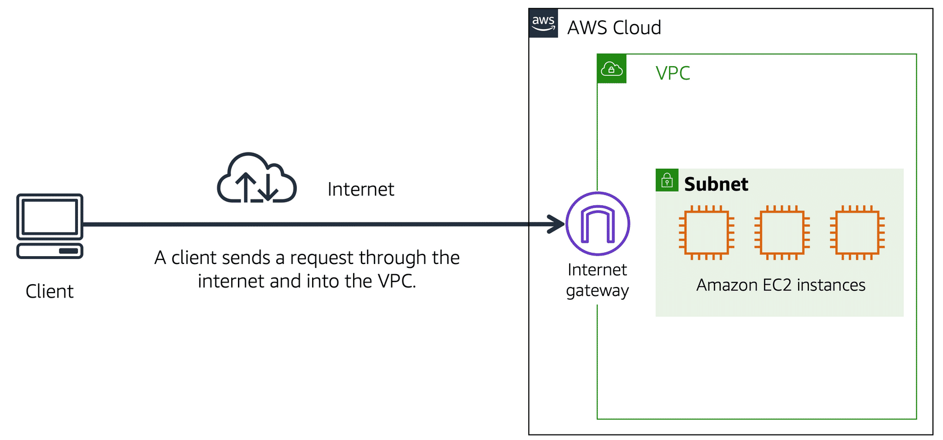
Services of AWS
A VPC is a virtual network dedicated to AWS account. It is logically isolated from other virtual networks in the AWS Cloud. You can specify an IP address range for the VPC, add subnets, add gateways, and associate security groups.

Slide 11
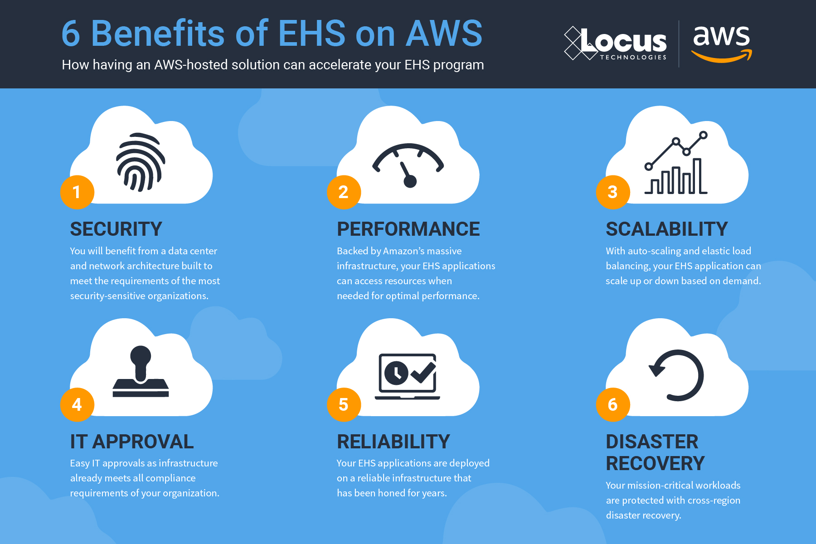
Benefits of AWS
Security
Performance
Scalability
IT Approval
Reliability
Disaster Recovery

Slide 12





Real Time Applications
AWS Cloud Virtual Internship
﻿Media Streaming
Health Care
Social Media
E-commerce
Gaming
IoT
AI & ML
Enterprise Applications
214G1A32122

Slide 13
Learning Outcomes
Learn various types of Cloud Computing.
Understand data storage, retrieval, and management using AWS databases like RDS.
Learn best practices for securing AWS environments, including identity and access management (IAM).
Gain knowledge in setting up and managing virtual private clouds (VPCs) and VPNs.
Work on real-world projects and case studies to apply AWS knowledge and skills.

Slide 14
Conclusion
From this internship I learnt about AWS cloud services offered to companies in real time applications.
The AWS Cloud Virtual Internship offers a robust and comprehensive learning experience, equipping participants with essential skills and knowledge in cloud computing.
Knowledge and skills acquired through this internship set a solid foundation for a career in cloud computing.

Slide 15
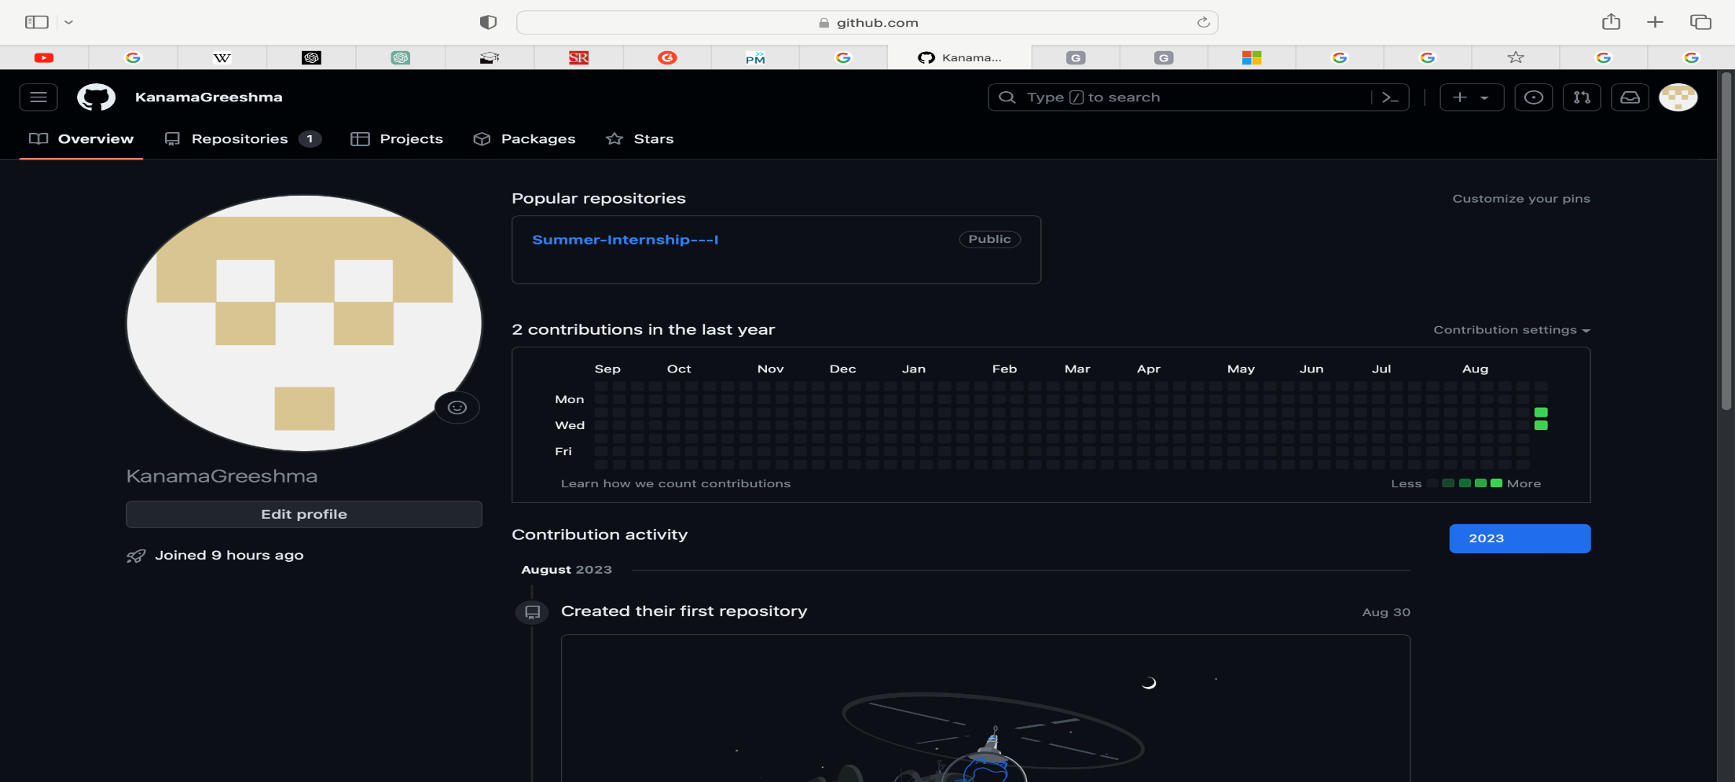
Git Hub Dashboard
AWS Cloud Virtual Internship
Repository Name : Summer Internship – I
Git Hub Link: //github.com/
214G1A32122

Slide 16
AWS Cloud Virtual Internship
Thank You!!!
214G1A32122

Slide 17
AWS Cloud Virtual Internship
Any Queries?
214G1A32122

